Slide 1

IMDB Data Web scraping, EDA and Visualization
Team Members:
Sangeetha Nair - 100884883
Viviana Lopez - 100873273
Jasmeet Kaur - 100881373
Shubham Jindal - 100843466

Slide 2
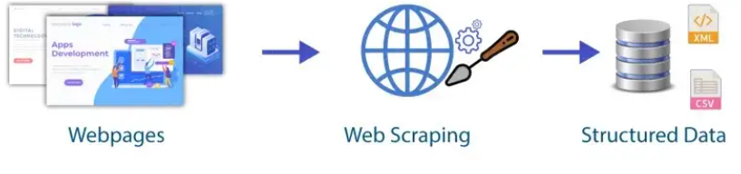
What is web scraping?
It is the process of parsing and extracting data from websites. We can scrape data using different tools like Beautiful Soup, Selenium, etc.

Slide 3
Steps to scrape a web page
Generally speaking, there are 3 steps to scrape a webpage:
Request to visit that particular webpage, just like what your browser does, and download the HTML contents into your environment. We used requests module to accomplish this. urllib2, urllib3 are also available choices.
BeautifulSoup module can be used to parse HTML contents. In addition to that, it provides very powerful and useful functions, searching through the soup object to match for text and HTML tags within the page.
Extract what you want from the webpage and download/store them for further analysis.

Slide 4
Project description
For this project, we scraped data from IMDb’s “Top 1000” movies. The information gathered from each movie are:
- Rank
- Movie Name
- Rating
- Movie URL
- Movie Year
- Genre
- Director Name
- IMDB Rating
- Metascore
- Actors

Slide 5
Libraries used:
Requests(to download the webpage)
Beautiful Soup(to parse the HTML content)
etree module from lxml(to parse the xpath contents)
Pandas(to create Data Frame)
Numpy(to do mathematical operations)
Seaborn and Matplotlib(for EDA visualization)

Slide 6
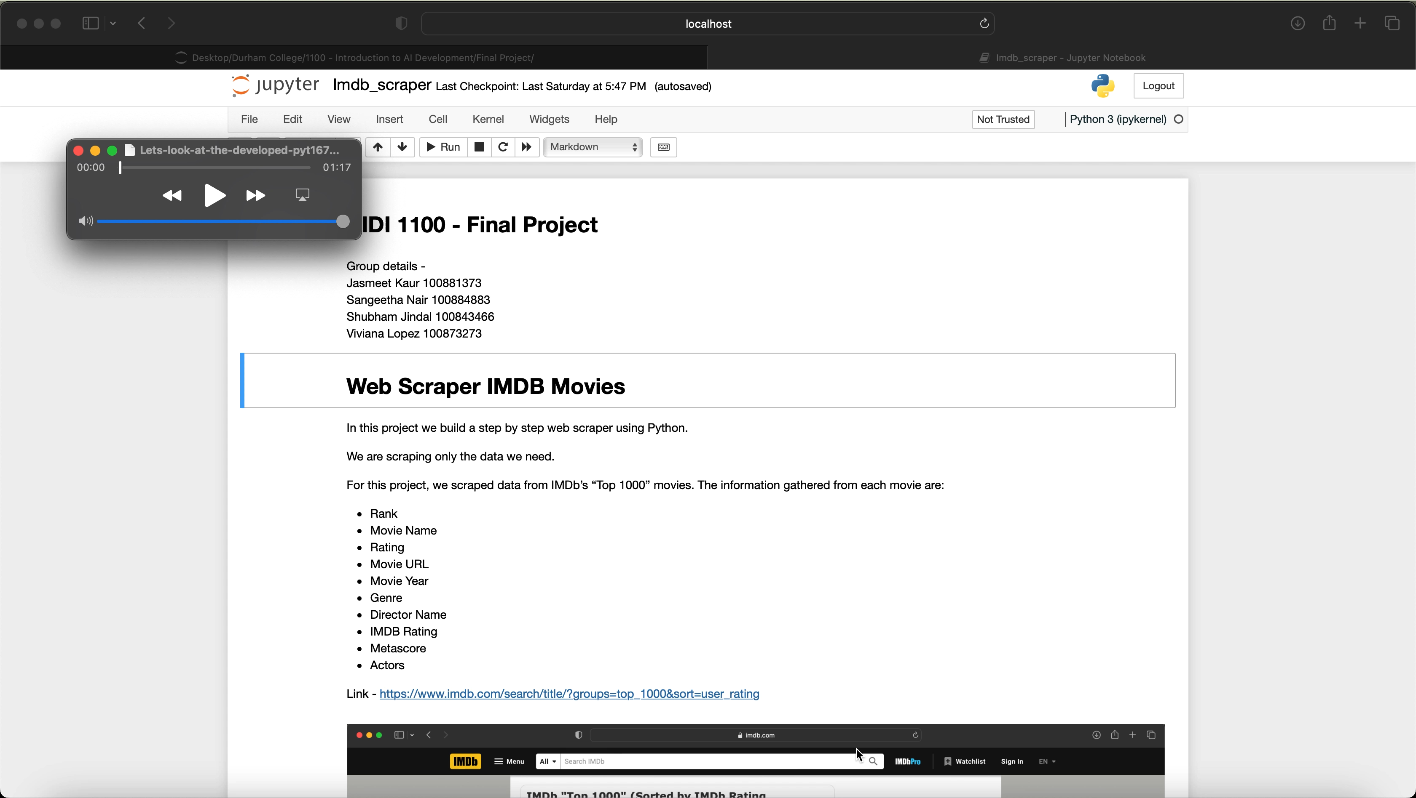
Python Code

Slide 7
Visualization

Slide 8
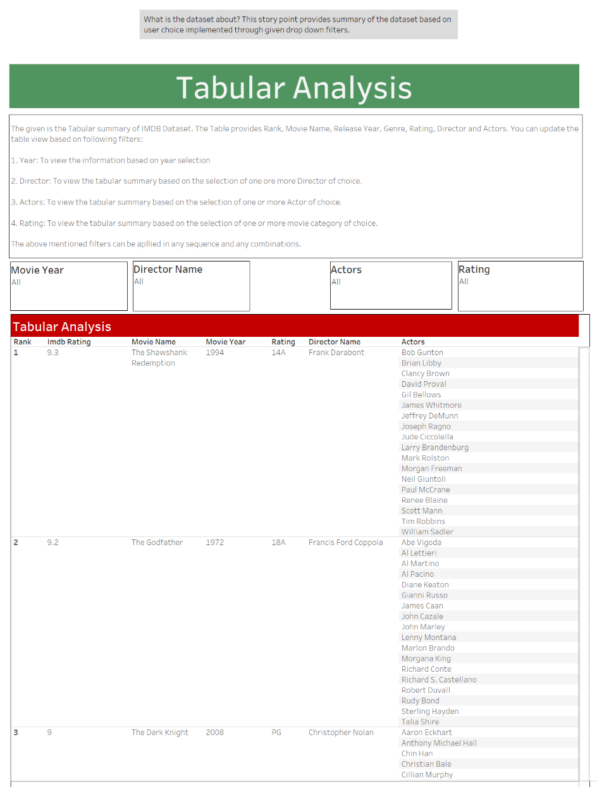
Analysis: 1
The question under consideration for this analysis is: What is the dataset about i.e., the dashboard provides summary of the data?
This story point provides summary of the dataset based on user choice implemented through given drop-down filters.

Slide 9
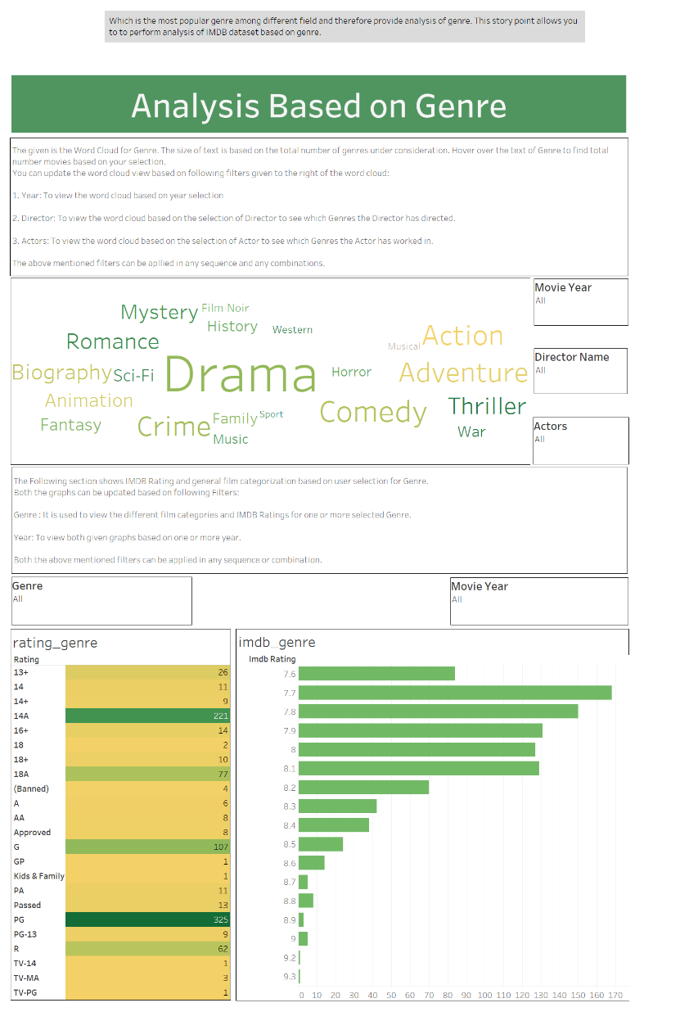
Analysis: 2
The question under consideration for this analysis is: Which is the most popular genre among different field and therefore provide analysis of ‘Genre’ field?
This story point of tableau allows the user to perform analysis of IMDB dataset based on genre.

Slide 10
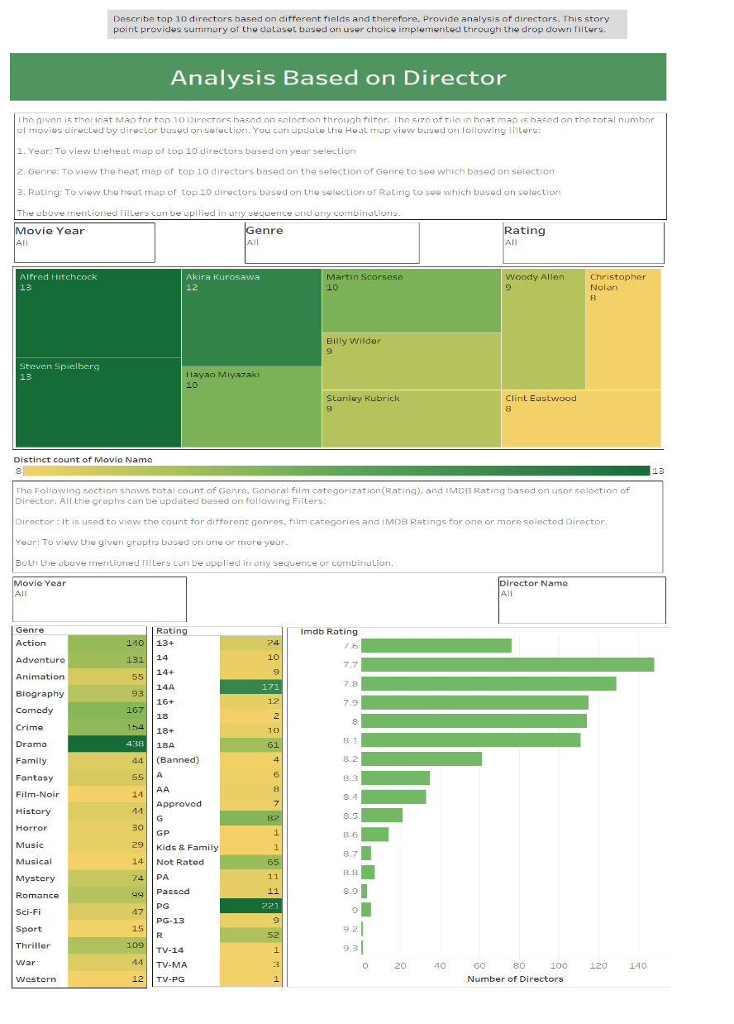
Analysis: 3
The question under consideration for this analysis is: Describe top 10 directors based on different fields and therefore, Provide analysis of ‘Directors’ field.
This story point provides summary of the dataset based on user choice implemented through the drop-down filters.

Slide 11
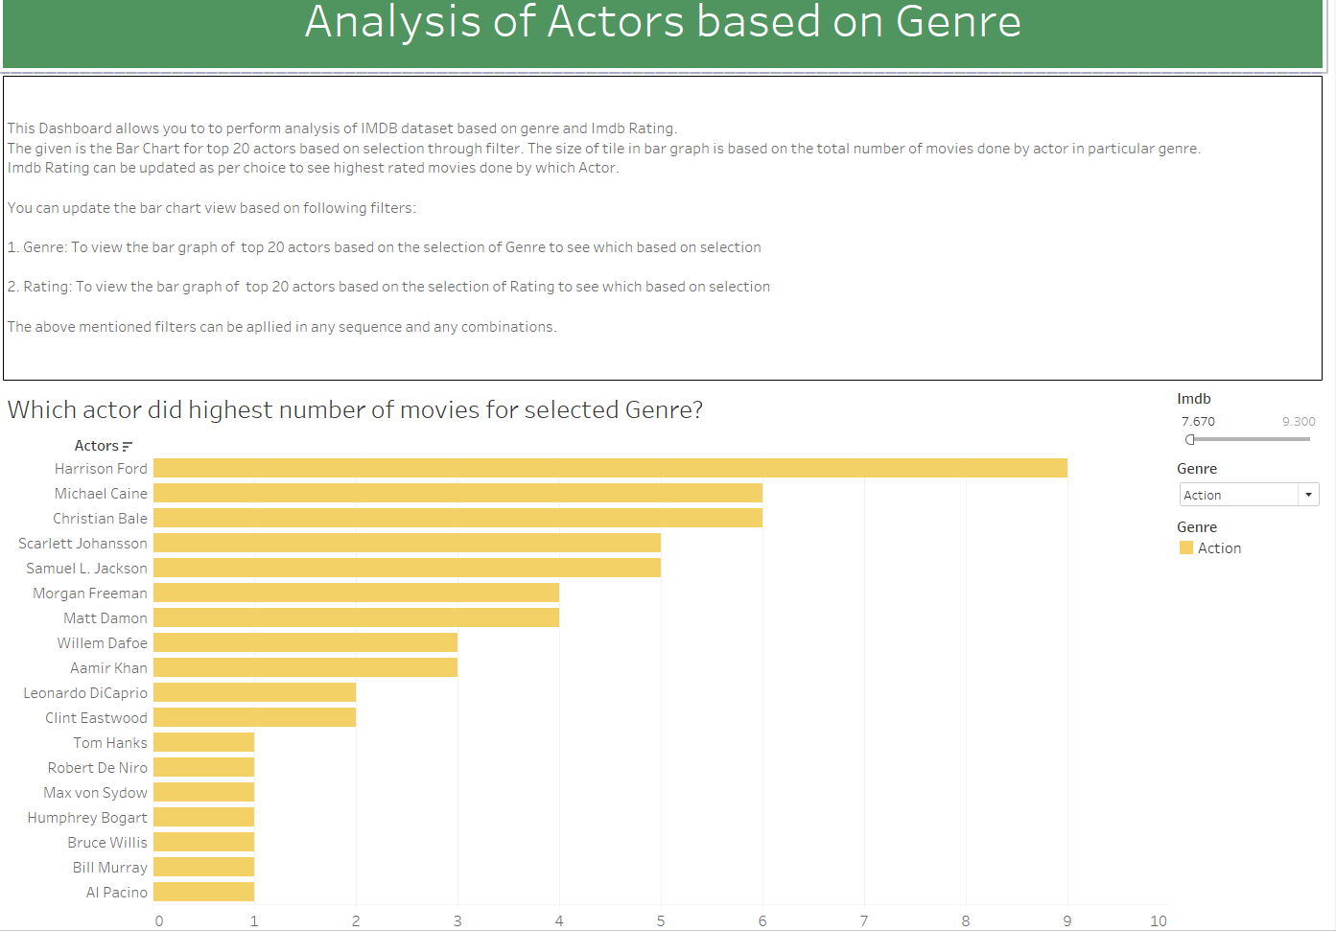
Analysis: 4
The question under consideration for this analysis is: Which Actor did highest number of movies for selected Genre?
This story point provides information about top 20 actors who did highest numbers of movies for given genre. This information can be viewed as per Imdb rating and genres of choice.

Slide 12
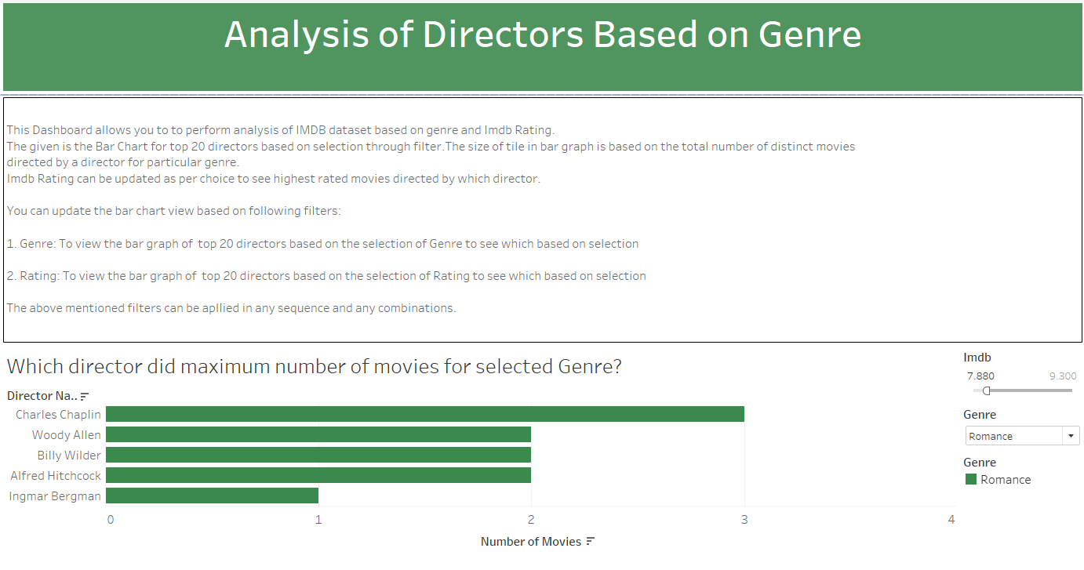
Analysis: 5
The question under consideration for this analysis is: Which Director did maximum number of movies for selected genre?
This story point provides information about top 20 directors who directed maximum numbers of movies for genre. This information can be viewed as per Imdb rating and genres of choice..

Slide 13
Credits
Thank You!
Sangeetha Nair - Project POC
Viviana Lopez - Project Specialist
Jasmeet Kaur - Business Analyst
Shubham Jindal - Project Architect

